Slide 1
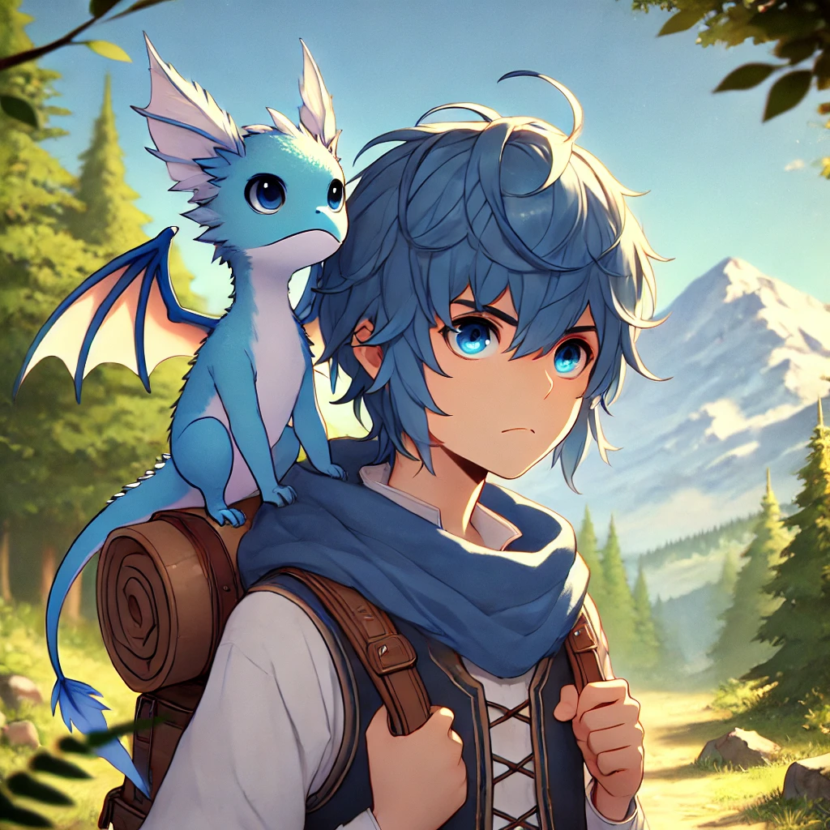
1.目標
Notes:
"An anime-styled scene of a young boy with tousled blue hair and large expressive blue eyes, standing in a forest with mountains in the background. He is wearing a traveler's outfit with a blue scarf, backpack, and vest. A small, adorable blue dragon with bat-like wings and big round eyes is perched on his shoulder, giving the scene a fantasy-adventure feel. The lighting is warm and soft, with the sun illuminating the lush green trees and distant snow-capped mountain."

Slide 2
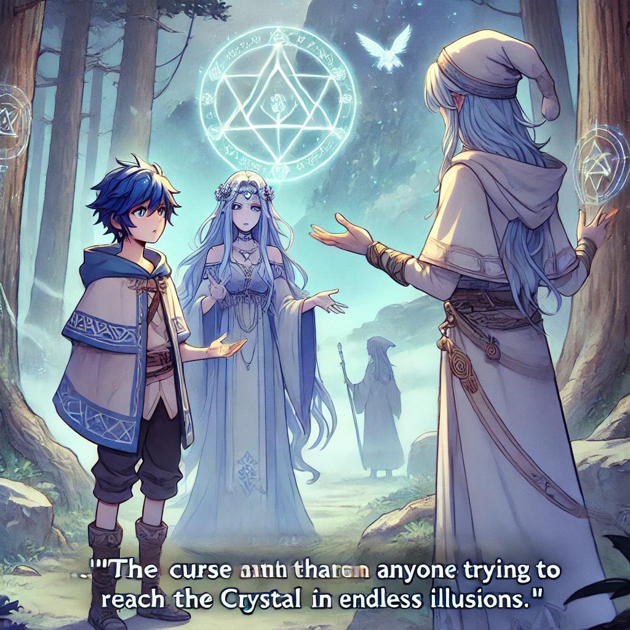
2.阻礙
Notes:
"An anime-styled scene set in a mystical forest at the foot of a mountain. The young boy, Arkell, with blue hair and a determined expression, stands before an ancient group of elven guardians. He wears a traveler's outfit with a blue-embroidered cloak and carries a sense of urgency. The elven guardians, dressed in long, flowing robes with ethereal designs, warn Arkell about a powerful curse that traps anyone who seeks the Crystal in an endless maze of illusions. Glowing magical symbols float in the air, illuminating the scene with a mystical light. Behind the elves, the path to the mountain seems shrouded in fog, symbolizing the danger ahead. The atmosphere is tense yet magical, with a glowing sigil overhead and ancient trees surrounding them."

Slide 3
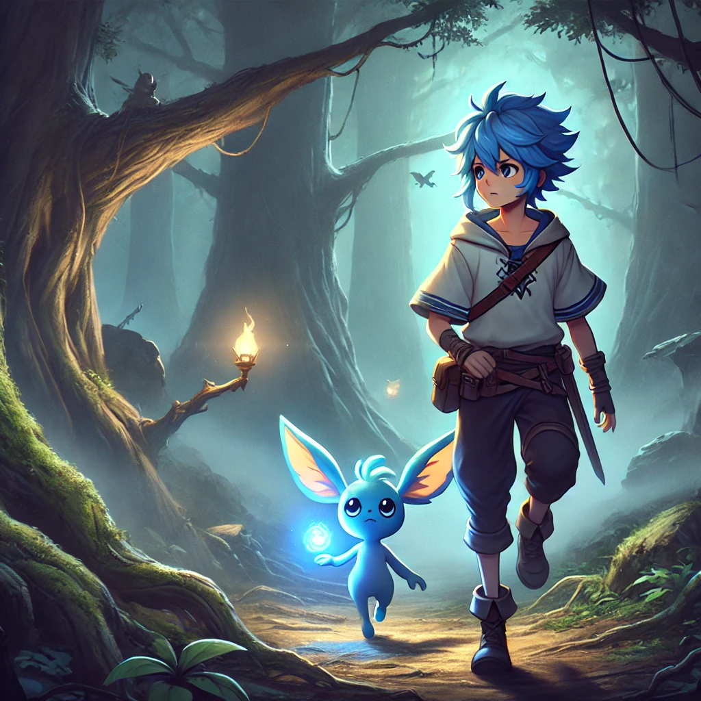
3.努力
Notes:
"A dark and misty forest path winds through towering trees, with thick fog creating an eerie and mysterious atmosphere. The young adventurer Arkell, now depicted in a more realistic style, walks cautiously. His clothes are worn, his posture determined but visibly tired from the journey. By his side is Aldo, a small but intelligent blue creature, glowing faintly with a soft blue light from its wings that pierces through the fog, guiding them. Arkell's facial features are more mature and realistic, with a sense of exhaustion and resolve in his expression. As they venture deeper into the dangerous terrain, hidden traps and the occasional shadow of a lurking beast add tension to their path. The realistic style adds weight to their struggle, showing Arkell's tattered clothes and Aldo's glowing wings as their only beacon in the dark."

Slide 4
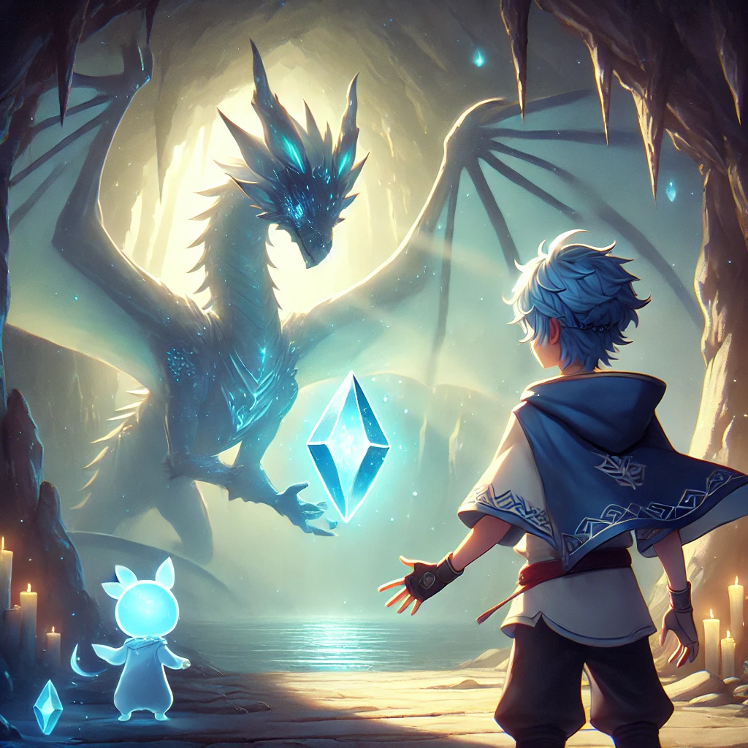
4.結果
Notes:
終於，經過無數的挑戰，他們站在了水晶洞窟的入口。洞窟內部寧靜而神秘，微弱的光線從洞穴深處的水晶中散發出來，仿佛在呼喚著亞克爾的到來。亞克爾心中滿是期待，覺得這場冒險即將迎來美好的結局。然而，當他走進洞窟並伸手觸碰水晶的瞬間，周圍的景象瞬間變化，光芒消失了，黑暗籠罩了整個洞窟。面前出現一個巨大的人物第四布的圖片 BOSS要改成龍 然後第五步的圖片角色不對 是主角與小寵物 不是兩個人

Slide 5
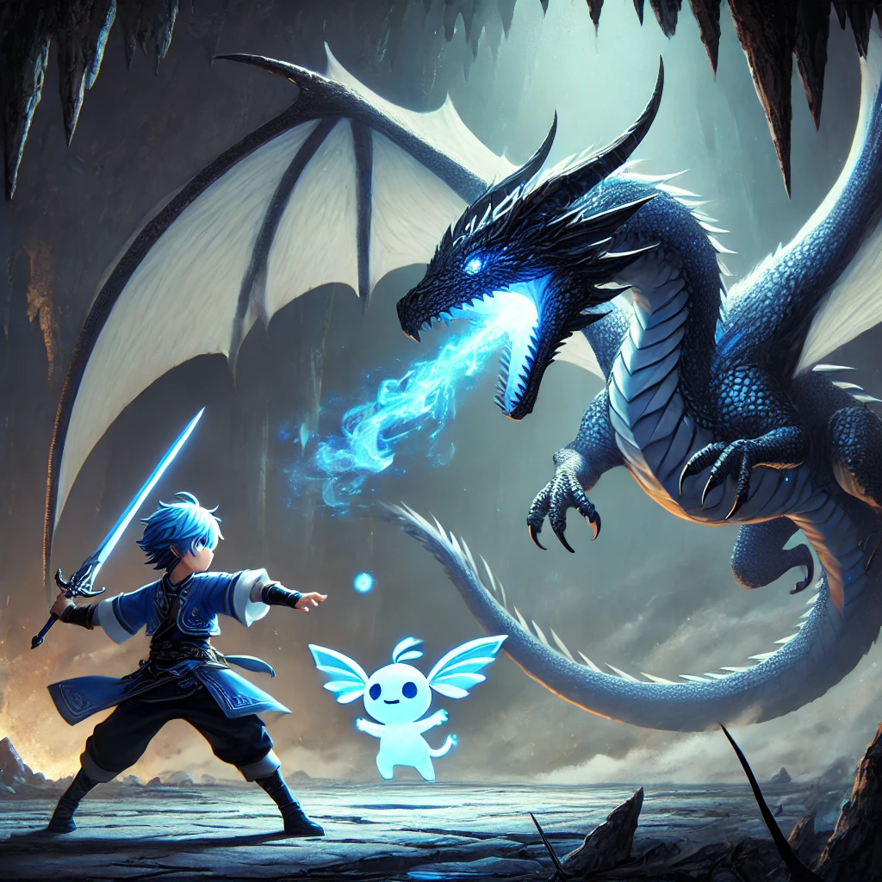
5.意外
Notes:
"Arkell and his small glowing companion, Aldo, stand at the entrance of a vast, mystical crystal cave. The cave is dimly lit, with eerie light emanating from a large blue crystal in the center, beckoning Arkell forward. As Arkell reaches out to touch the crystal, the tranquil atmosphere shatters, and the scene transforms. The light disappears, and the cave is plunged into darkness. In front of them, a massive dragon, glowing with blue energy, emerges from the shadows, towering over Arkell with menacing wings spread wide. The dragon's scales shimmer with the same light as the crystal, its eyes locked onto the adventurers. Arkell, with a mixture of awe and fear, prepares for the battle, while Aldo’s wings glow softly, ready to assist in the upcoming confrontation."

Slide 6
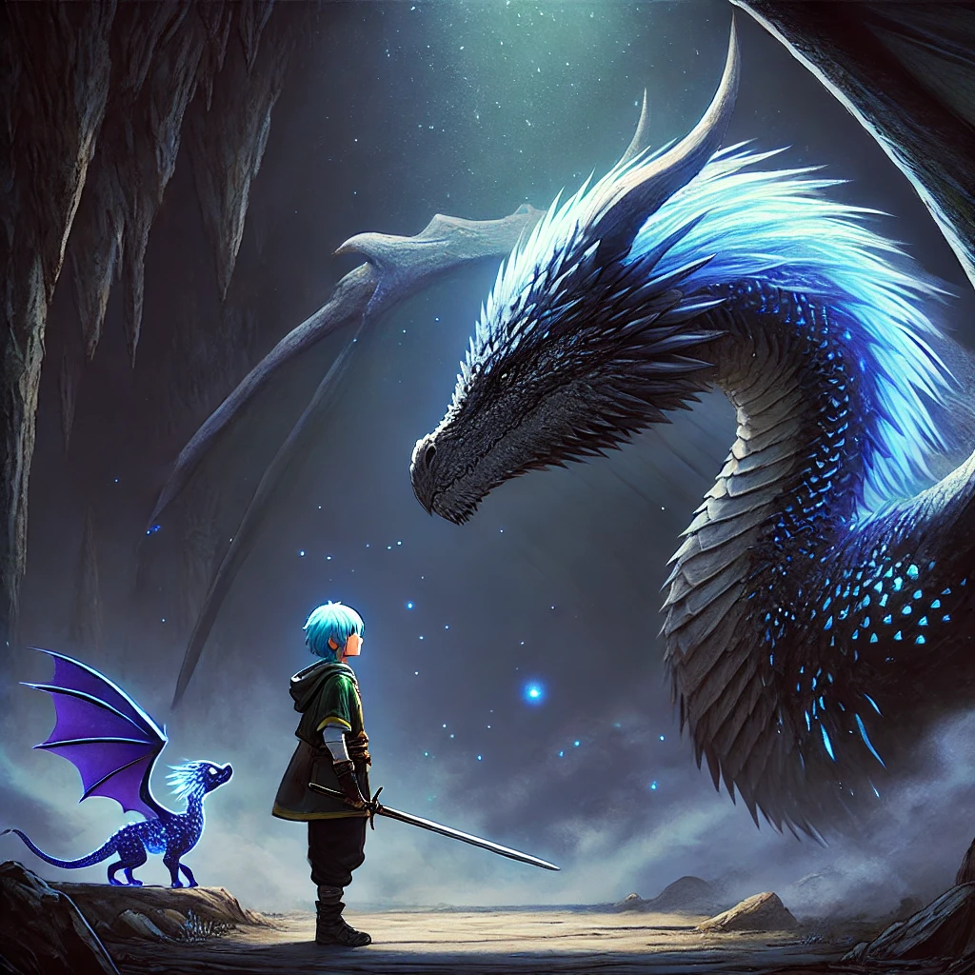
6.轉彎
Notes:
"Arkell stands face-to-face with the mighty Dragon King in the dimly lit cave. His sword is lowered, no longer held in a combat stance, as he realizes that this trial is not about strength, but the purity of his heart. The dragon, massive and shimmering with blue energy, looms over him, its intense gaze fixed on Arkell. Aldo, Arkell's loyal companion, hovers by his side, glowing softly in the darkness. Arkell speaks sincerely, telling the Dragon King that his quest is not for power, but to save his dying homeland. The dragon pauses its attack, its fierce form softening as it begins to dissolve into a gentle mist, a sign that Arkell has passed the trial of wisdom and heart. The atmosphere shifts from tense to serene, the cave illuminated by the soft glow of the fading dragon and the magical crystals scattered around."

Slide 7
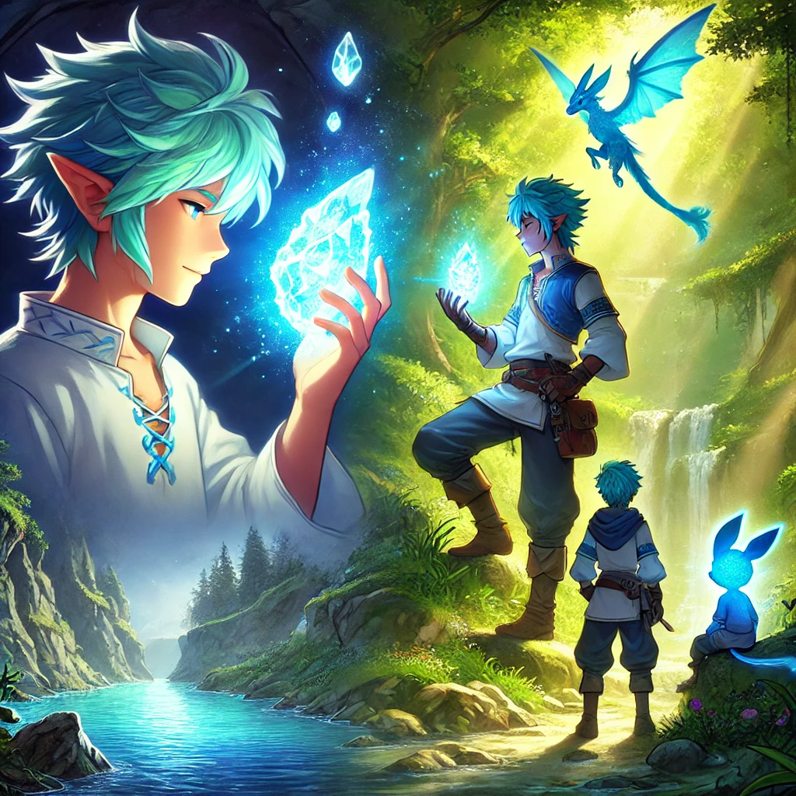
7.結局
Notes:
"After defeating the Dragon King, the cave once again glows with the ethereal light of the crystal. Arkell, now calm and focused, touches the glowing blue crystal, and a wave of energy flows into him. He feels a deep connection with nature, a power not just of physical strength but of harmony and renewal. As Arkell and Aldo return to their homeland, they use the crystal's magic to revive the dying forest. Trees begin to bloom with lush greenery, rivers flow crystal clear, and the land is restored. In the background, Arkell stands tall, holding the glowing crystal, as the vibrant landscape around him symbolizes the rebirth of nature. Aldo flies nearby, glowing softly, while the sky above is bright with hope, marking the successful completion of their adventure and the revival of the forest."

